Slide 1
Flutter Sessions
Dart Session 2

Slide 2
Topics:
Recap
Collections
Lists
Sets
Maps
Functions
Arrow Function
anonymous/lambda Function
Exceptions
Try, catch, finally
Throw
Async Programming
Future
Async/await
Stream/ *async
Intro to OOP
What’s the diff between class and object
How to create and use class in dart
Types of constructors

Slide 3
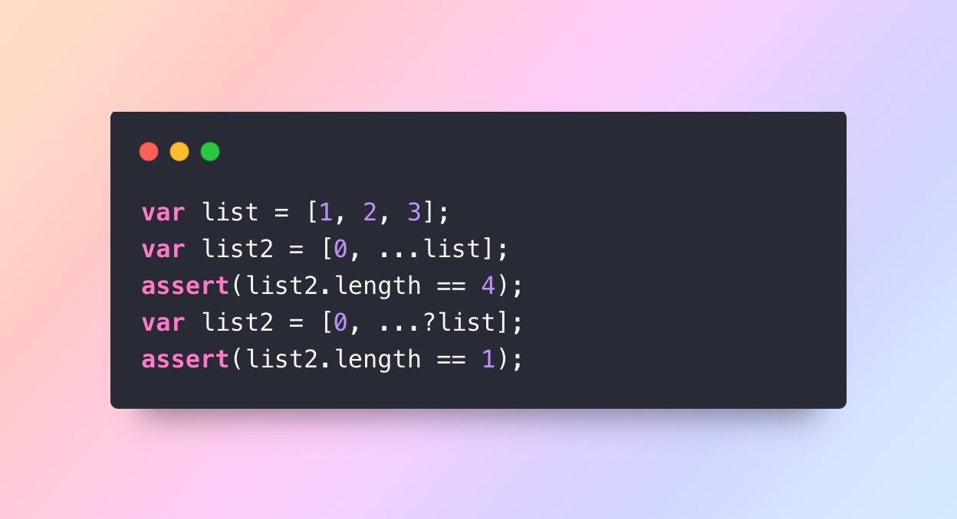
Collections:
Lists
Sets
Maps
spread operator (...) and the null-aware spread operator (...?)

Slide 4
Functions:
Like as everything in dart it’s object so you can define as variable or pass it to other function.
Type of Parametres:
Named parameters
Optional positional parameters

Slide 5
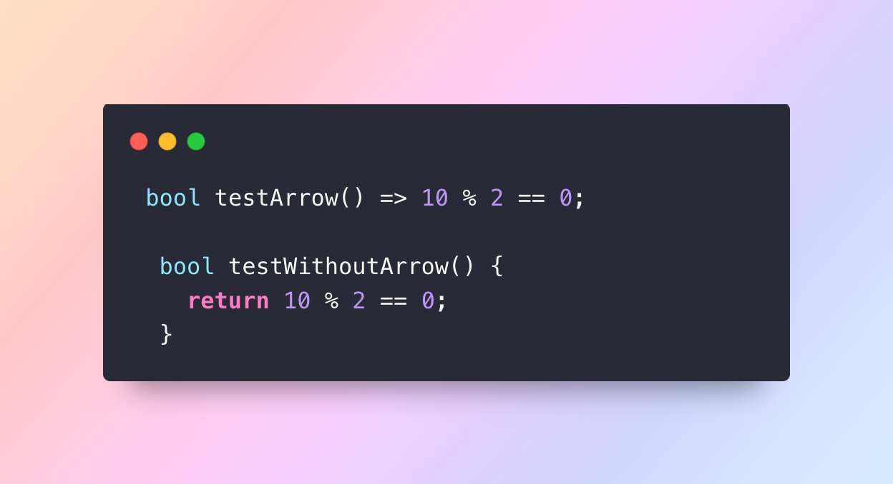
Arrow Function:
function => expr

